Slide 1
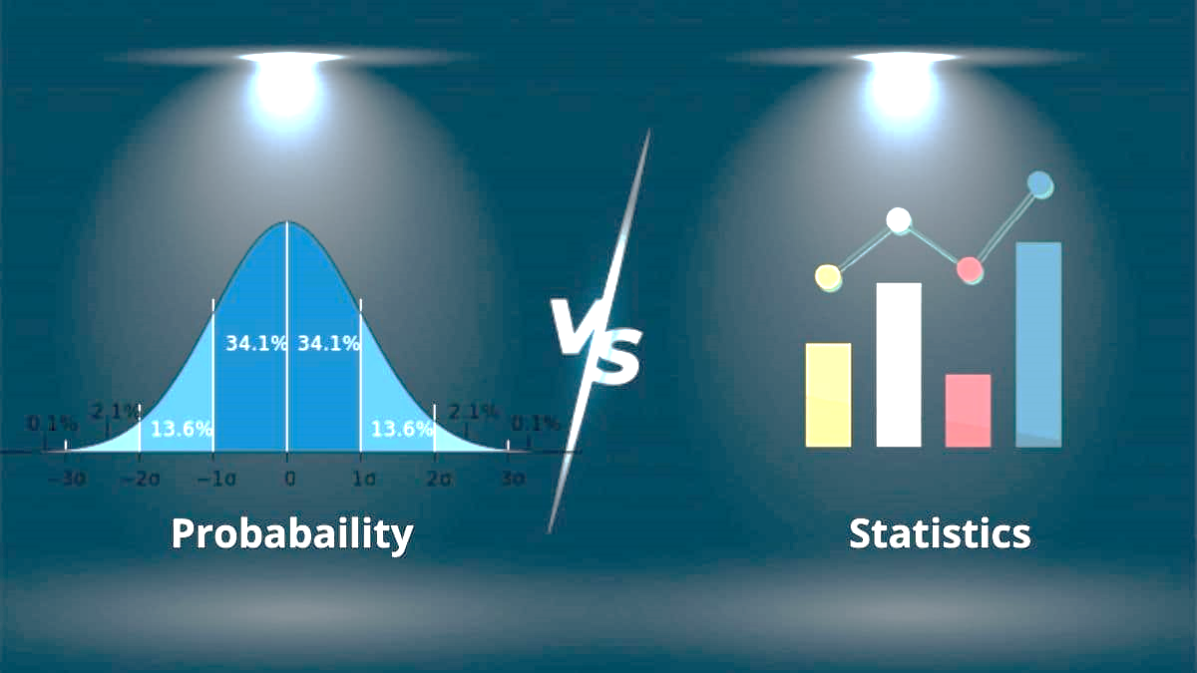
Probability and Statistics
Discovery and Learning with Big Data/Data Discovery

Slide 2

Data Collection
Statistics and Data Science
Statistics provides techniques for collecting, preparing, analyzing, interpreting and presenting data.
Data science relies on statistics to make data driven decisions and solve problems.
How?
Sampling: collect data efficiently and effectively, reduce bias.
Descriptive statistics: Explore the observed data ➔ visualizations/numerical summaries.
Inferential statistics: Allow for conclusions to be drawn about the population from the observed sample of data by using probability as the foundation.
Understanding the statistical techniques: Ensure results are appropriately interpreted and communicated.
Notes:
https://learn.zybooks.com/zybook/UNTADTA5340OrhanSpring2024/chapter/3/section/1

Slide 3

Example
A data scientist collaborates on a project with a zookeeper to study behavior changes in wild African painted dogs when a new dog is introduced into the pack.
An observational study is designed to collect behavior data on a random sample of dogs in the pack before and after the new dog is introduced.
Graphical and numerical summaries of the data show the proportion of aggressive behaviors increased by 0.096 (0.128 to 0.224) after the new dog was introduced.
The observed increase was found to be statistically greater than 0 which indicates aggressive behavior increases in the pack when a new dog is introduced.
The data scientist can report to the zookeeper that the data indicate introducing a new dog to the pack is associated with an increase in aggressive behavior.
Notes:
https://learn.zybooks.com/zybook/UNTADTA5340OrhanSpring2024/chapter/3/section/1

Slide 4
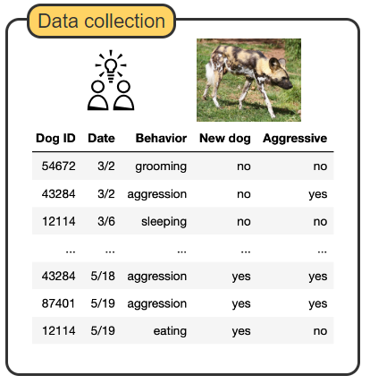
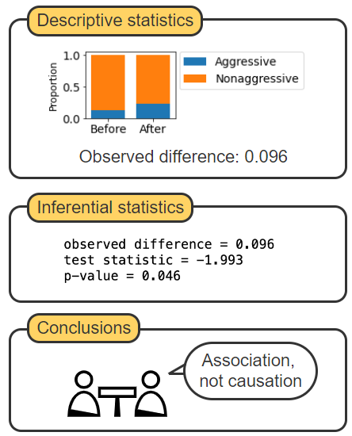
Notes:
https://learn.zybooks.com/zybook/UNTADTA5340OrhanSpring2024/chapter/3/section/1

Slide 5
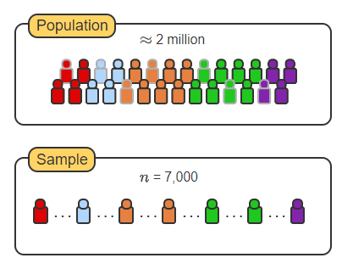
Population vs Sample
Goal is to analyze data to understand a population.
Population: Entire set of all individuals, items, or events of interest.
Obtaining data on the entire population = expensive, impractical ➔ use sample
Sample: Subset of the population, but should be representative and reduce bias by randomization, clustering etc.
Notes:
https://learn.zybooks.com/zybook/UNTADTA5340OrhanSpring2024/chapter/3/section/1

Slide 6

How to: Random sampling with Python
pandas is helpful
DataFrame.sample(n=None, frac=None, replace=False, random_state=None) ➔ random sample of items from a dataframe.
n or frac: The number, or fraction, of items to be returned in the sample.
replace: Sampling with (True) or without (False) replacement.
random_state: optionally sets the random number generator seed for reproducible sampling.
Notes:
https://learn.zybooks.com/zybook/UNTADTA5340OrhanSpring2024/chapter/3/section/1

Slide 7
Python sampling
# Import pandas package
import pandas as pd
# Load the dataset
paintings = pd.read_csv('bob_ross.csv’)
# Select a sample of 20 paintings, without replacement, from
# the paintings dataframe
sample20Paintings = paintings.sample(n=20, replace=False)
Notes:
https://learn.zybooks.com/zybook/UNTADTA5340OrhanSpring2024/chapter/3/section/1

Slide 8

Descriptive statistics
Descriptive statistics refers to the summary of important aspects of a data set.
Includes collecting, organizing, and presenting the data in the form of charts and tables.
Often calculate numerical measures (typical value: mean, median, mode; variability: variance, standard deviation).
Understanding a feature: examine the feature's distribution which is the possible values the feature can take on and a measure of how often each value occurs.
Visualizing a feature's distribution with a graph gives insights into the distribution's shape. For numerical features:
A cluster is a distinct group of neighboring values in a distribution that occur noticeably more often than the values on either side of the group.
The tails of a distribution are the end values of the distribution.
Examples?
Notes:
https://learn.zybooks.com/zybook/UNTADTA5340OrhanSpring2024/chapter/3/section/2

Slide 9
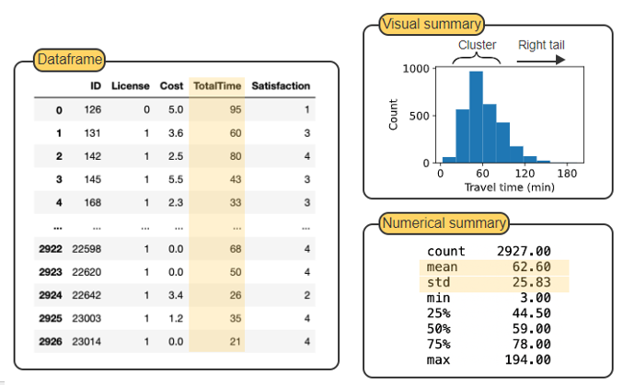
Notes:
https://learn.zybooks.com/zybook/UNTADTA5340OrhanSpring2024/chapter/3/section/2

Slide 10
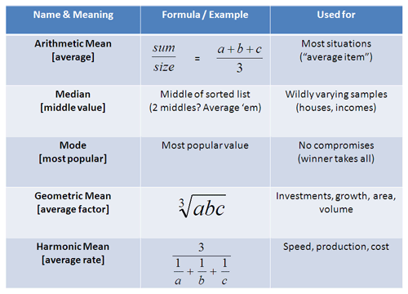
Measures of Center

Slide 11
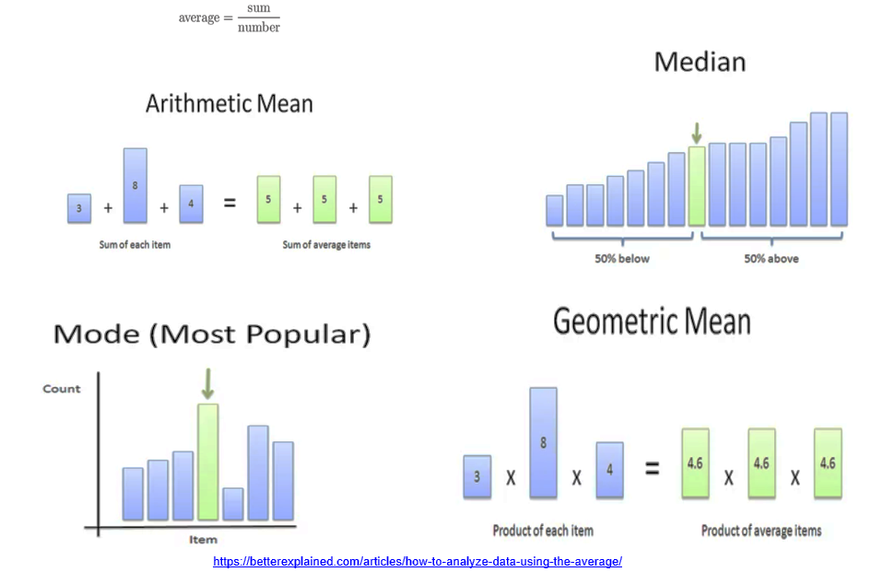

Slide 12

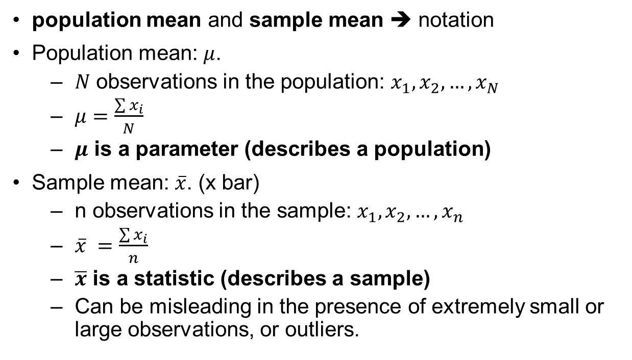
Measures of Center
population mean and sample mean ➔ notation
Population mean: $μ$.
$N$ observations in the population: $x_{1},x_{2},…,x_{N}$
$μ=\frac{\sum{x_{i}}}{N}$
$μ$ is a parameter (describes a population)
Sample mean: $\overline{x}$. (x bar)
n observations in the sample: $x_{1},x_{2},…,x_{n}$
$\overline{x} =\frac{\sum{x_{i}}}{n}$
$\overline{x}$ is a statistic (describes a sample)
Can be misleading in the presence of extremely small or large observations, or outliers.

Slide 13

Measures of Center
Mean⬅ outliers ➔ median.
Median ➔ middle value.
Divides the data in half
The middle value if n (or N) is odd
The average of the two middle values if n (or N) is even
mean != median ➔ outliers.
Example: 1, 1, 2, 2, 3, 4, 100
Mean:16.143
Median: 2

Slide 14

Measures of Center
Mode ➔ observation that occurs most frequently.
There can be one or more modes, or even no mode.
One mode: unimodal
Two modes: bimodal
More than three modes ➔ not useful
Just because an observation occurs with the most frequency does not guarantee that it best reflects the center of the variable
Example: 1, 1, 2, 2, 3, 4, 100
Mean:16.143
Median: 2
Mode: 1 or 2

Slide 15
Measures of Center
To summarize a categorical variable, the mode is the only meaningful measure of central location.
Example: sizes of women’s sweatshirts
The sizes are S, M, or L.
S and M appear 2 times each, L appears 5 times.
The modal size is L.

Slide 16

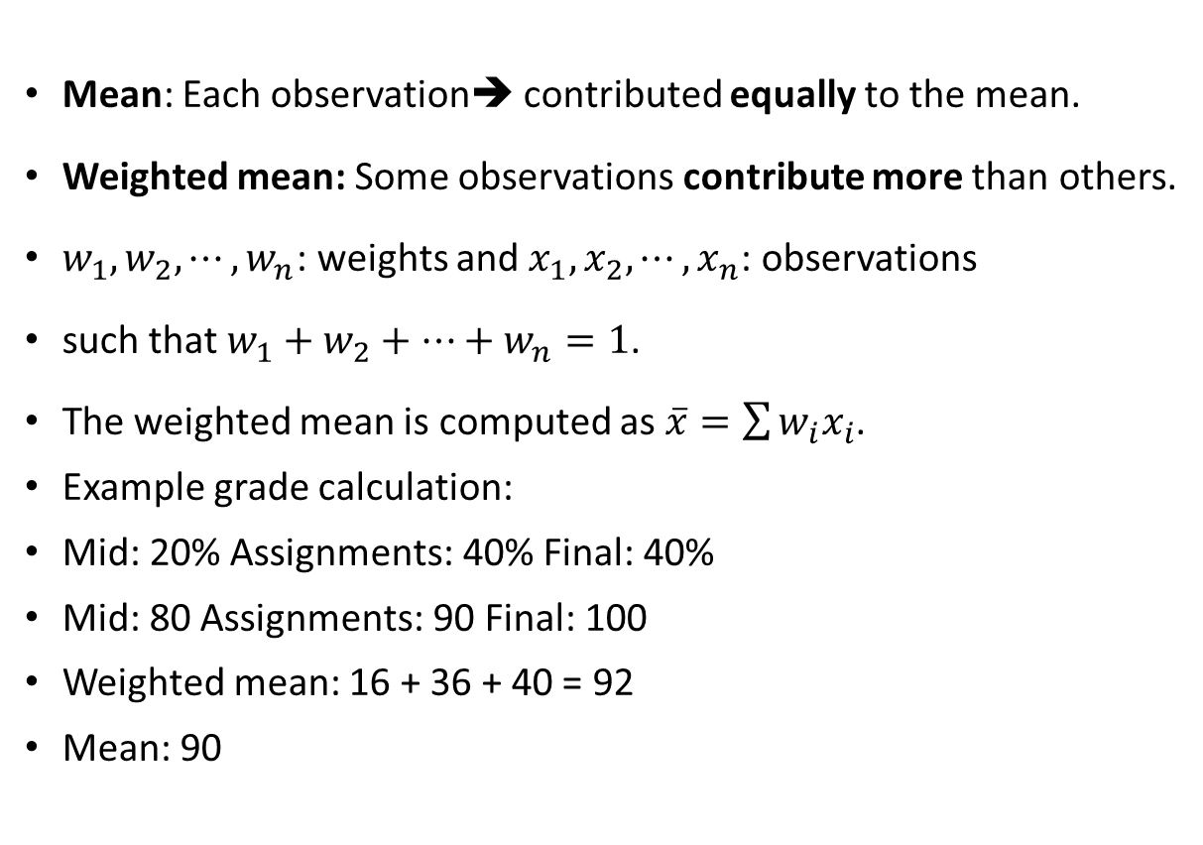
Measures of Center
Mean: Each observation➔ contributed equally to the mean.
Weighted mean: Some observations contribute more than others.
$w_{1},w_{2},⋯,w_{n}$: weights and $x_{1},x_{2},⋯,x_{n}$: observations
such that $w_{1}+w_{2}+⋯+w_{n}=1$.
The weighted mean is computed as $\overline{x}=\sum{w_{i}x_{i}}$.
Example grade calculation:
Mid: 20% Assignments: 40% Final: 40%
Mid: 80 Assignments: 90 Final: 100
Weighted mean: 16 + 36 + 40 = 92
Mean: 90

Slide 17
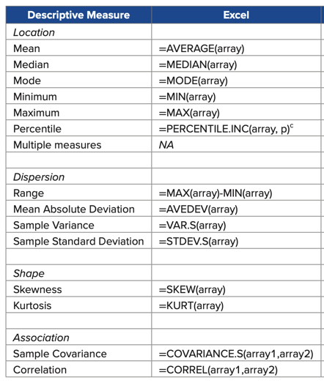

Slide 18

Measures of Spread
Measures of center ➔ no information about dispersion/spread.
Measures of dispersion/spread
0 indicates all the observations are identical
Increases as the observations become more diverse
The range is the simplest measure.
Range = Max – Min
Not good because it focuses solely on extreme observations

Slide 19
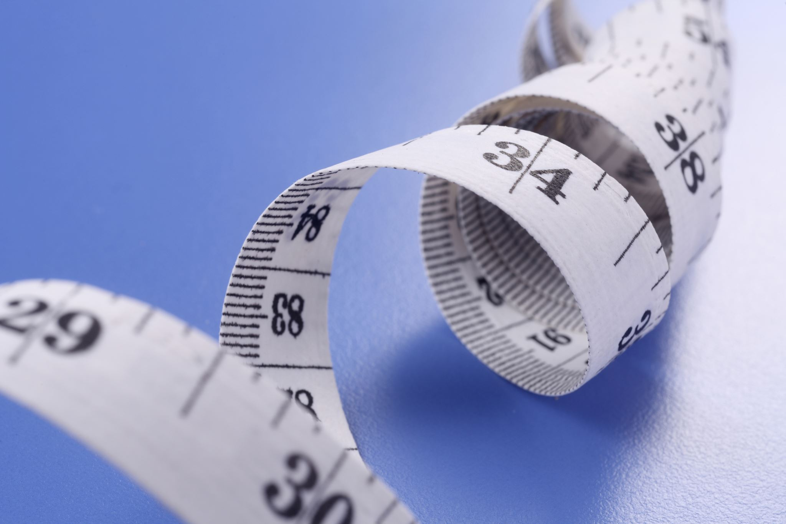
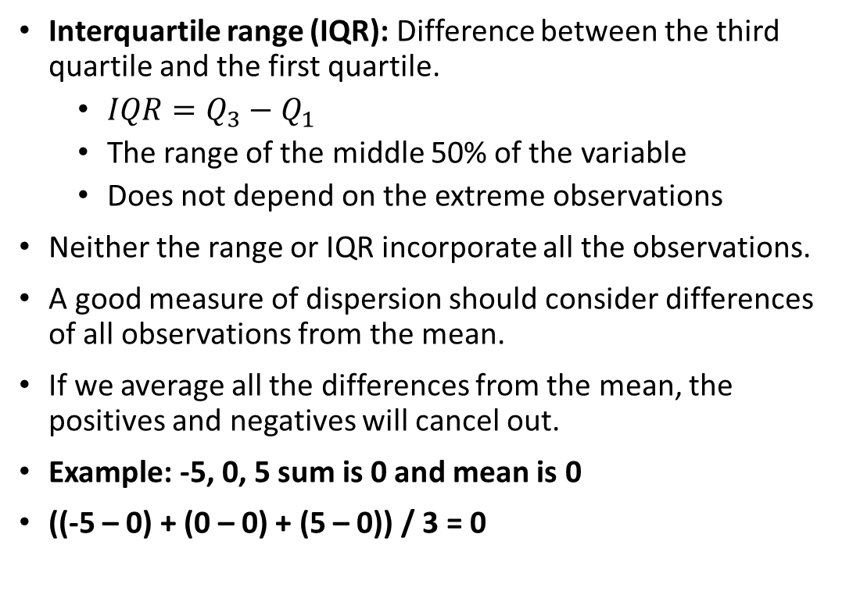
Measures of Spread
Interquartile range (IQR): Difference between the third quartile and the first quartile.
$IQR=Q_{3}−Q_{1}$
The range of the middle 50% of the variable
Does not depend on the extreme observations
Neither the range or IQR incorporate all the observations.
A good measure of dispersion should consider differences of all observations from the mean.
If we average all the differences from the mean, the positives and negatives will cancel out.
Example: -5, 0, 5 sum is 0 and mean is 0
((-5 – 0) + (0 – 0) + (5 – 0)) / 3 = 0

Slide 20

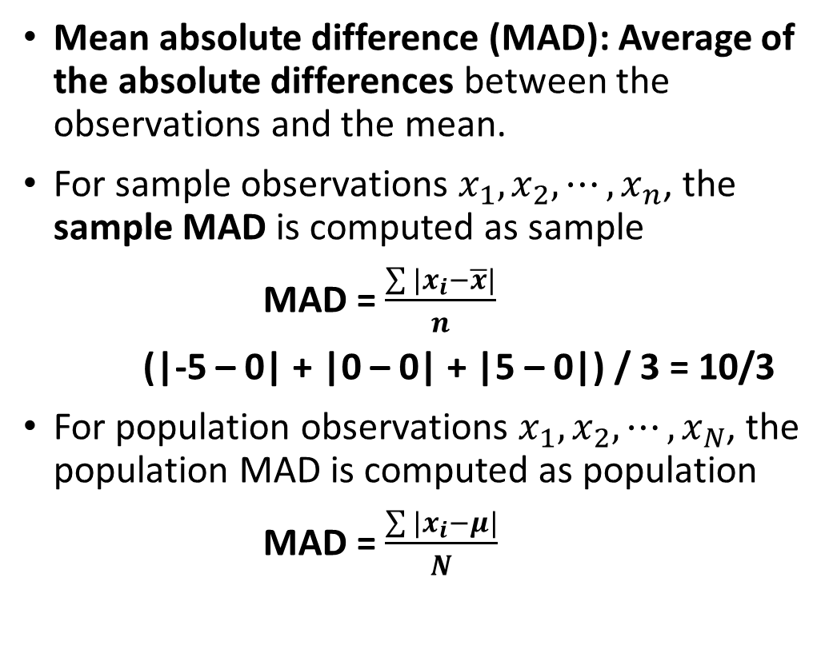
Measures of Spread
Mean absolute difference (MAD): Average of the absolute differences between the observations and the mean.
For sample observations $x_{1},x_{2},⋯,x_{n}$, the sample MAD is computed as sample
MAD = $\frac{\sum{|x_{i}−\overline{x}|}}{n}$
(|-5 – 0| + |0 – 0| + |5 – 0|) / 3 = 10/3
For population observations $x_{1},x_{2},⋯,x_{N}$, the population MAD is computed as population
MAD = $\frac{\sum{|x_{i}−μ|}}{N}$

Slide 21

Measures of Spread
The variance and the standard deviation are the two most widely used measures of dispersion.
Compute the average of the squared differences
The squaring of the differences emphasizes larger differences
The variance is defined as the average of the squared differences between the observations and the mean.
Whatever the units of original variable, the variance has squared units.
To return to the original units, we take the positive square root of the variance which gives the standard deviation.

Slide 22

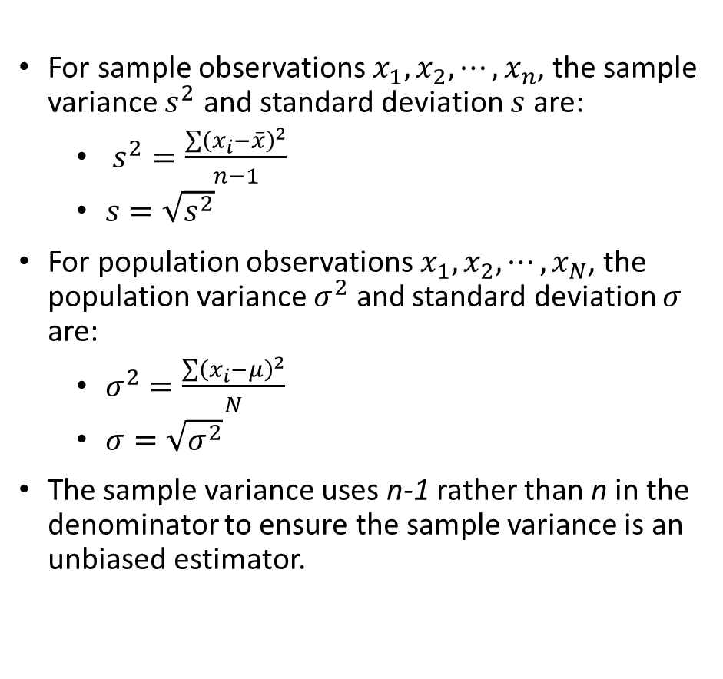
Measures of Spread
For sample observations $x_{1},x_{2},⋯,x_{n}$, the sample variance $s^{2}$ and standard deviation $s$ are:
$s^{2}=\frac{\sum{{\left(x_{i}−\overline{x}\right)}^{2}}}{n−1}$
$s=\sqrt{s^{2}}$
For population observations $x_{1},x_{2},⋯,x_{N}$, the population variance $σ^{2}$ and standard deviation $σ$ are:
$σ^{2}=\frac{\sum{{\left(x_{i}−μ\right)}^{2}}}{N}$
$σ=\sqrt{σ^{2}}$
The sample variance uses n-1 rather than n in the denominator to ensure the sample variance is an unbiased estimator.

Slide 23
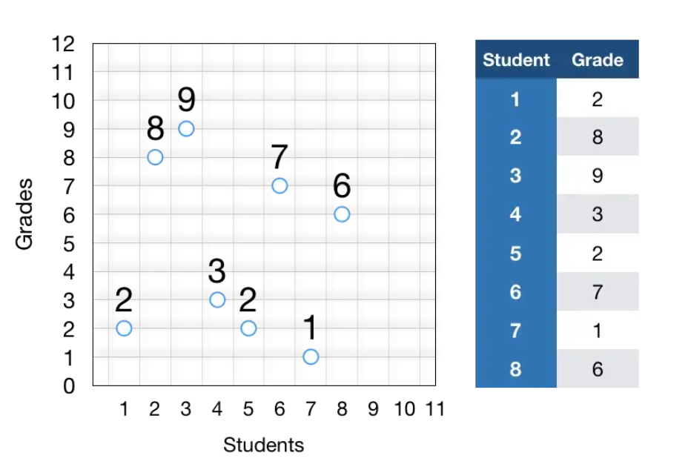
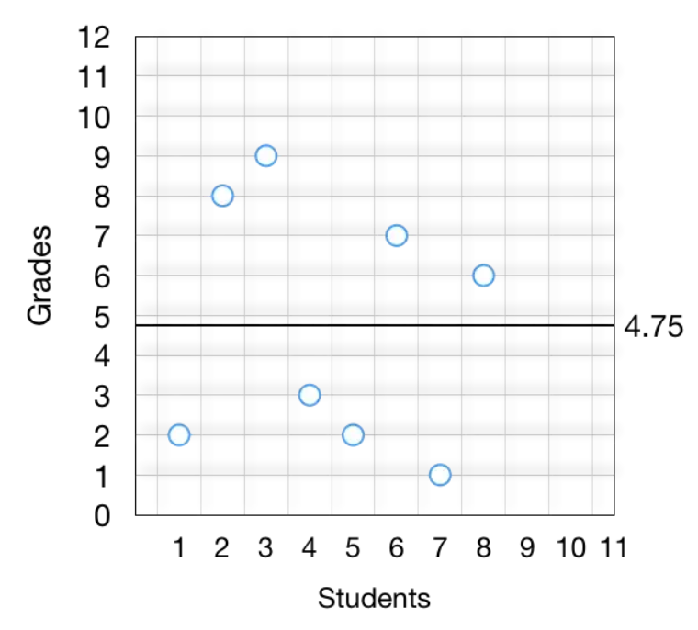
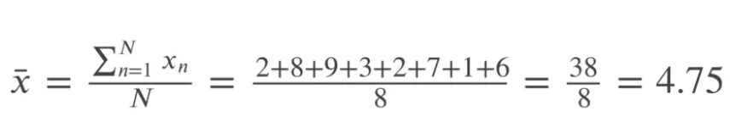
A visual interpretation of the standard deviation

Slide 24
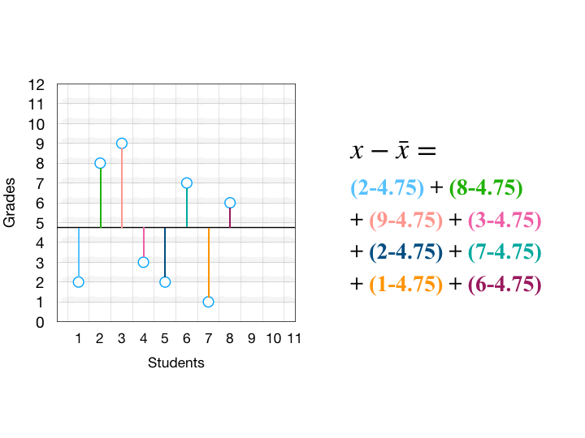
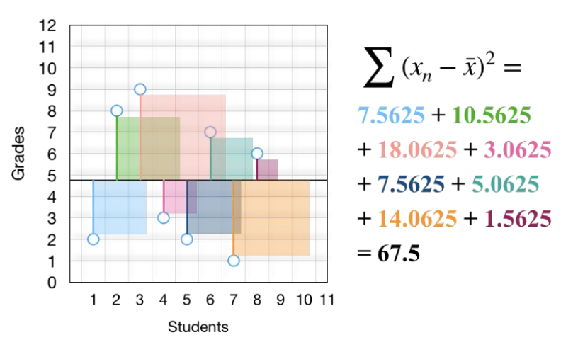
A visual interpretation of the standard deviation
sum of squares we effectively calculated the total variability (i.e., differences) in those grades
What 67.5 means is that if we stack all those squares in a mega square, its area will be equal to 67.5 points2, where points here refers to the unit of grades. The total variability of any set of measurements is an area of a square.
“squaring” is really nothing but drawing a square

Slide 25
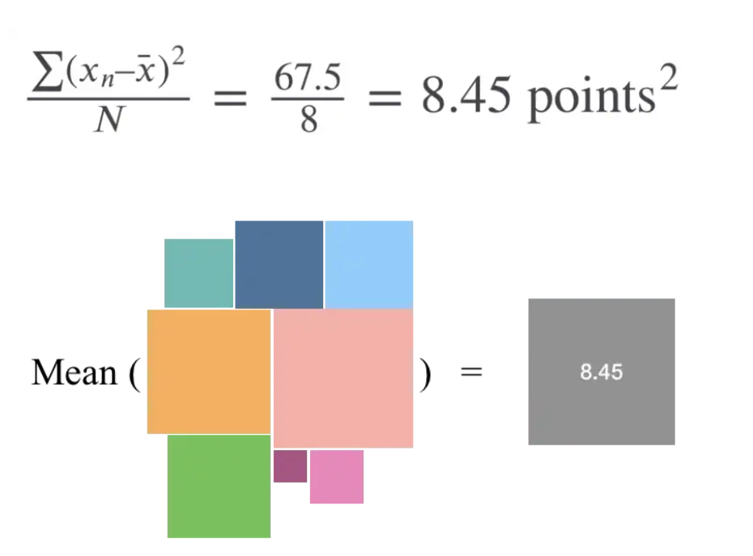
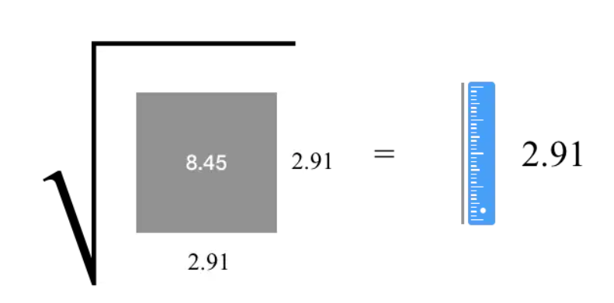
A visual interpretation of the standard deviation
Variance: To find that mean, we just divide the total area by the number of squares
Standard deviation: To find that mean, we just divide the total area by the number of squares and get the square root to find one side

Slide 26
Measures of position
The mean and standard deviation alone don’t tell us about relative location.
Low standard deviation: observations are close to the mean
High standard deviation: observations are spread out
How to find where they are?

Slide 27

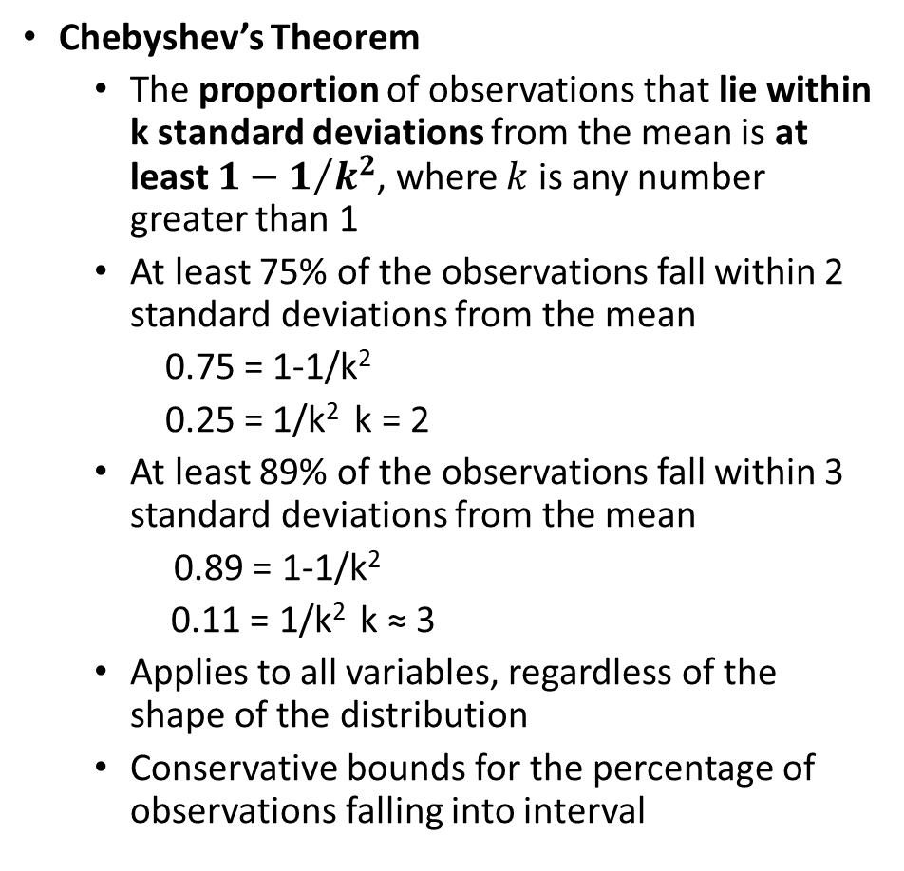
Measures of position
Chebyshev’s Theorem
The proportion of observations that lie within k standard deviations from the mean is at least $1−1/{k^{2}}$, where $k$ is any number greater than 1
At least 75% of the observations fall within 2 standard deviations from the mean
0.75 = 1-1/k²
0.25 = 1/k² k = 2
At least 89% of the observations fall within 3 standard deviations from the mean
0.89 = 1-1/k²
0.11 = 1/k² k ≈ 3
Applies to all variables, regardless of the shape of the distribution
Conservative bounds for the percentage of observations falling into interval

Slide 28

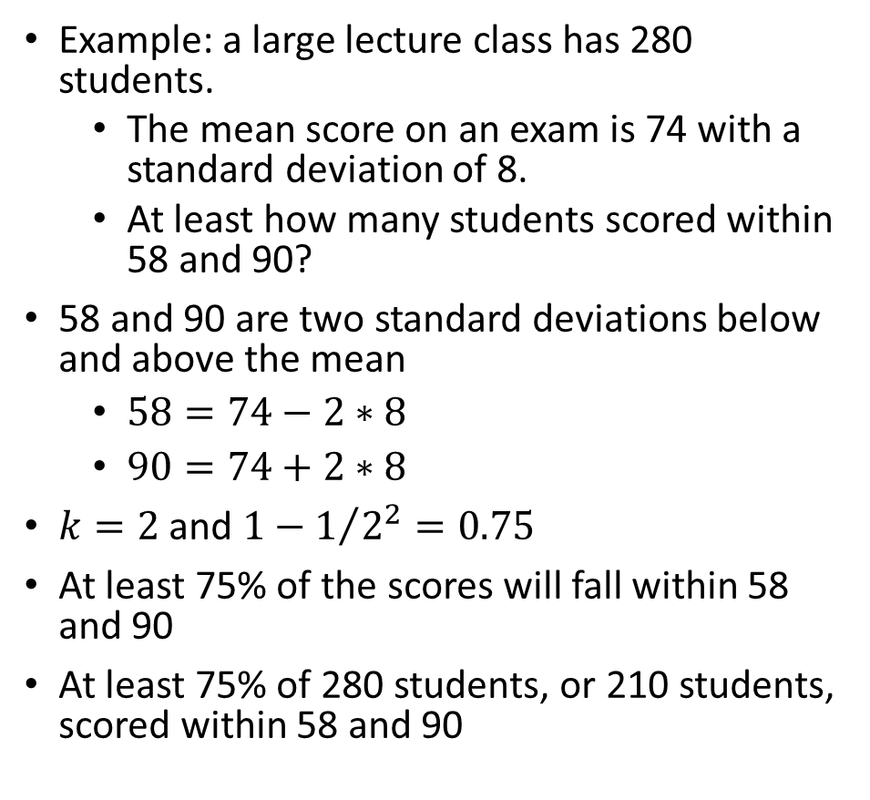
Measures of position
Example: a large lecture class has 280 students.
The mean score on an exam is 74 with a standard deviation of 8.
At least how many students scored within 58 and 90?
58 and 90 are two standard deviations below and above the mean
$58=74−2∗8$
$90=74+2∗8$
$k=2$ and $1−1/{2^{2}}=0.75$
At least 75% of the scores will fall within 58 and 90
At least 75% of 280 students, or 210 students, scored within 58 and 90

Slide 29

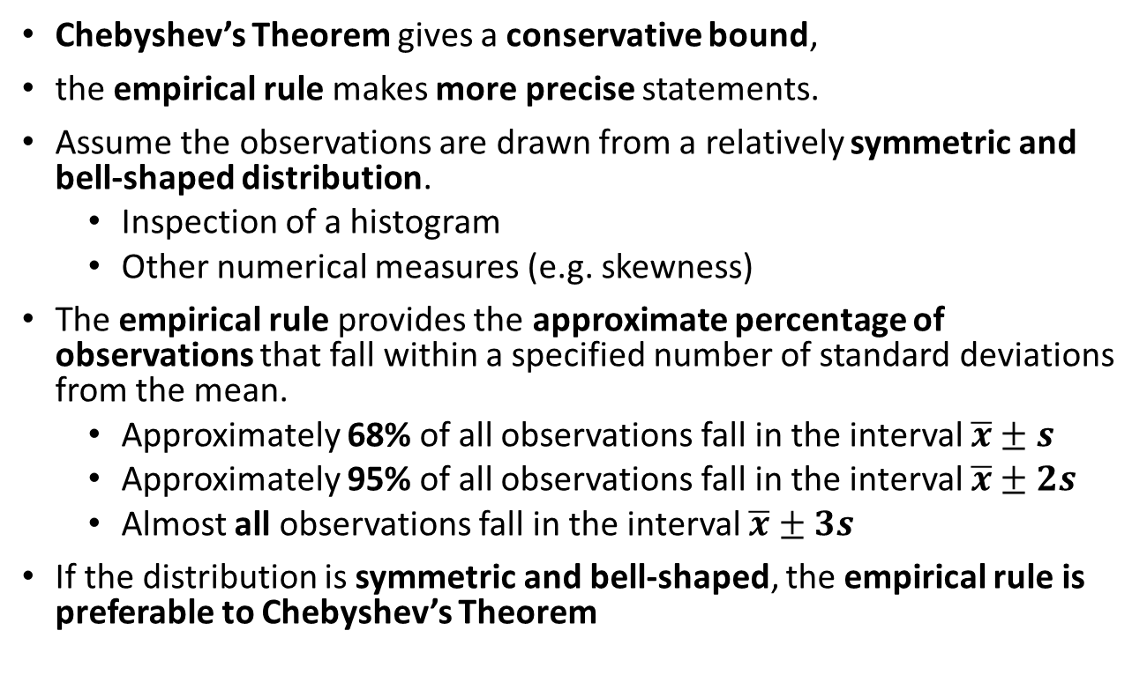
Measures of position
Chebyshev’s Theorem gives a conservative bound,
the empirical rule makes more precise statements.
Assume the observations are drawn from a relatively symmetric and bell-shaped distribution.
Inspection of a histogram
Other numerical measures (e.g. skewness)
The empirical rule provides the approximate percentage of observations that fall within a specified number of standard deviations from the mean.
Approximately 68% of all observations fall in the interval $\overline{x}±s$
Approximately 95% of all observations fall in the interval $\overline{x}±2s$
Almost all observations fall in the interval $\overline{x}±3s$
If the distribution is symmetric and bell-shaped, the empirical rule is preferable to Chebyshev’s Theorem

Slide 30
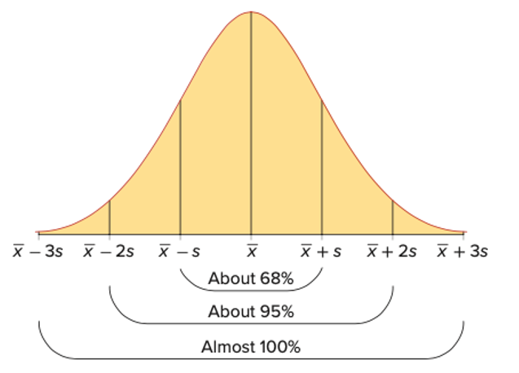
Measures of position

Slide 31

Measures of position
Example: a large lecture class has 280 students.
The mean score on an exam is 74 with a standard deviation of 8.
Approximately how many students scored within 58 and 90?
Approximately how many students scored more than 90?
58 and 90 are two standard deviations below and above the mean.
So about 95% of 280 students, or 266, scored within 58 and 90.
90 is two standard deviations above the mean.
95% of the observations fall within two standard deviations of the mean, 5% fall outside the interval
Given the symmetry of the distribution, 2.5% scored above 90
2.5% of the 280 students, or about 7, scored above 90 on the exam

Slide 32

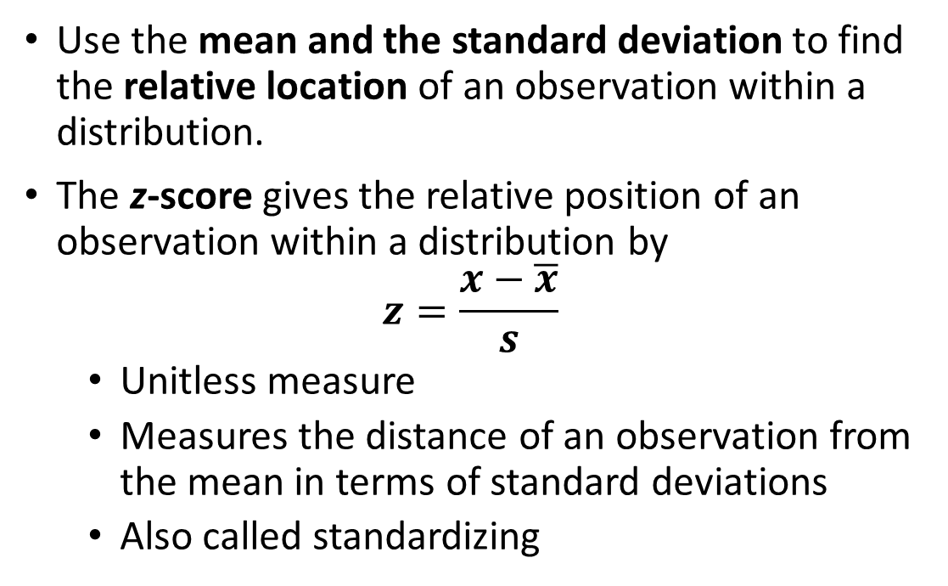
Measures of position
Use the mean and the standard deviation to find the relative location of an observation within a distribution.
The z-score gives the relative position of an observation within a distribution by
$$z=\frac{x−\overline{x}}{s}$$
Unitless measure
Measures the distance of an observation from the mean in terms of standard deviations
Also called standardizing

Slide 33
Measures of position
If the distribution is relatively symmetric and bell-shaped, use z-scores to detect outliers.
Since almost all observations are within three standard deviations of the mean, an observation is an outlier if its z‑score is more than 3 or less than −3.
Such observations must be reviewed to determine if they should remain in the data set. ???

Slide 34
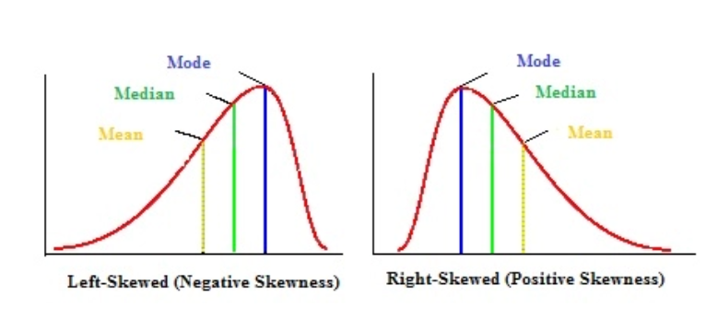
Measures of shape
A distribution is symmetric if one side of the histogram is a mirror image of the other.
For a symmetric and unimodal distribution mean=median=mode
Positively skewed: mean is usually greater than the median (mean>median)
Negatively skewed: the mean is usually less than the median (mean<median)

Slide 35
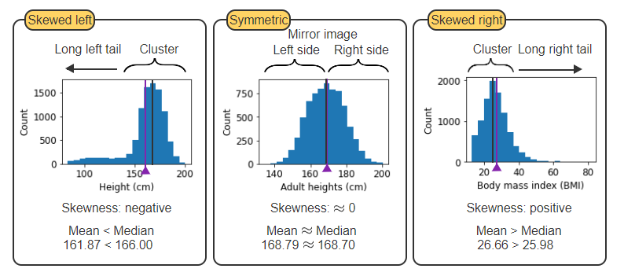
Notes:
https://learn.zybooks.com/zybook/UNTADTA5340OrhanSpring2024/chapter/3/section/2

Slide 36
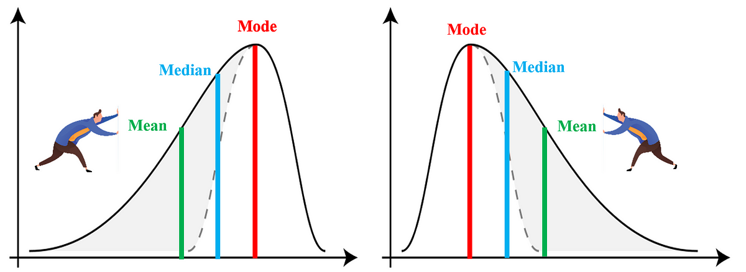
Measures of shape
The skewness coefficient is a measure of skewness.
Zero: observations are evenly distributed on both sides of the mean (symmetric)
Positive: extreme observations in the right tail, pulling the mean up relative to the median
mean ➔ increase
Negative: extreme observations in the left tail, pulling the mean down relative the median
mean ➔ decrease

Slide 37
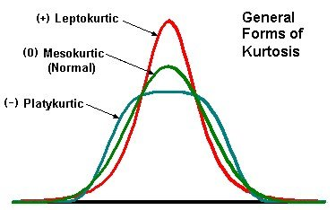
Measures of shape
Kurtosis is a measure of tail heaviness or peakedness of the distribution . Larger values of kurtosis indicate a greater presence of extreme values in the distribution.
Notes:
https://financetrain.sgp1.cdn.digitaloceanspaces.com/KurtosisPict.jpg

Slide 38
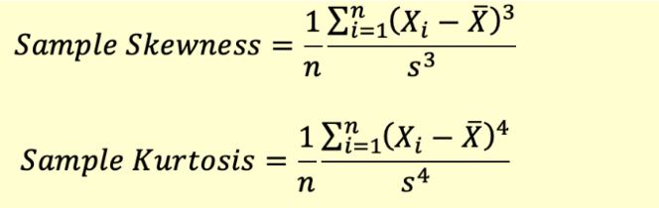

Slide 39
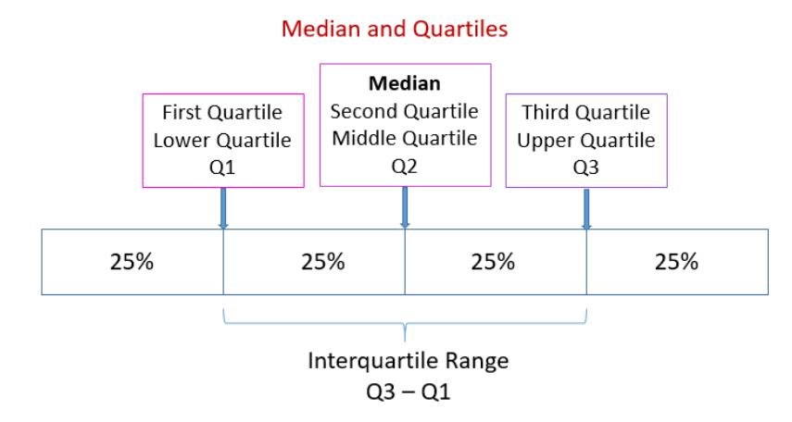
Measures of shape
A percentile divides the data into two parts.
Approximately p percent of the observations are less than the p^{th} percentile
Approximately 1-p percent of the observations are greater than the p^{th} percentile
A percentile is a measure of location.
It is also used as a measure of relative position because it is easy to interpret.
When we calculate the 25th, 50th, and 75th percentiles for a variable, we have divided it into four equal parts or quarter.
25th percentile: Q1
50th percentile: Q2
75th percentile: Q3
It only makes sense to calculate percentile for larger data sets.

Slide 40
Python: Descriptive Statistics
Method | Parameters | Description
DataFrame.mean() DataFrame.median() | axis=None skipna=True | Returns the mean or median of the values over the requested axis. skipna=True excludes NA/null values.
DataFrame.var() DataFrame.std() | axis=None skipna=True ddof=1 | Returns the unbiased sample variance (divides by n-1) or standard deviation of the values over the requested axis. The divisor used is n-ddof, where n represents the number of non-NA/null values.
DataFrame.min() DataFrame.max() | axis=None skipna=True | Returns the minimum or maximum of the values over the requested axis.
DataFrame.quantile() | q=0.5 axis=None interpolation='linear' | Returns the value of the given quantile(s), q, over the requested axis. interpolation specifies the method to determine a quantile when the quantile lies between two values.
DataFrame.skew() | axis=None skipna=True | Returns the skewness of the values over the requested axis.
DataFrame.kurtosis() | axis=None skipna=True | Returns the kurtosis of the values over the requested axis. Computes Fisher's definition of kurtosis where a normal distribution has 0 kurtosis.
DataFrame.describe() | percentiles=None | Returns descriptive statistics. For numerical features, results include the count, mean, standard deviation, minimum, maximum, 0.25 quantile, 0.50 quantile or median, and 0.75 quantile. The returned percentiles can be modified with percentiles.

Slide 41
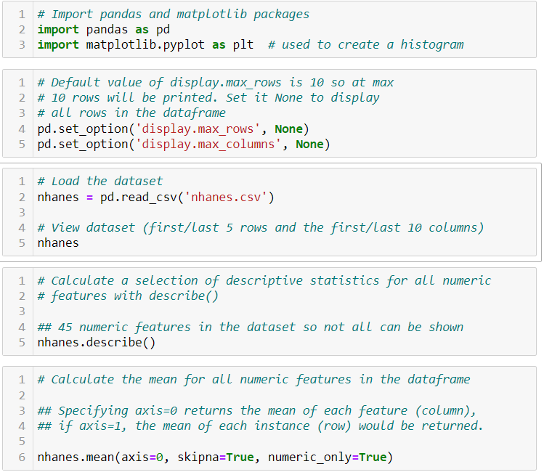
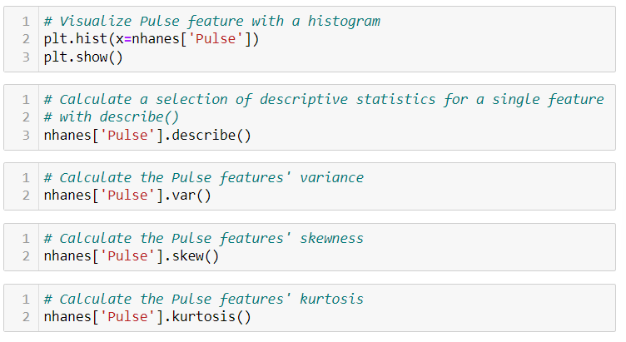

Slide 42

Probability

Slide 43

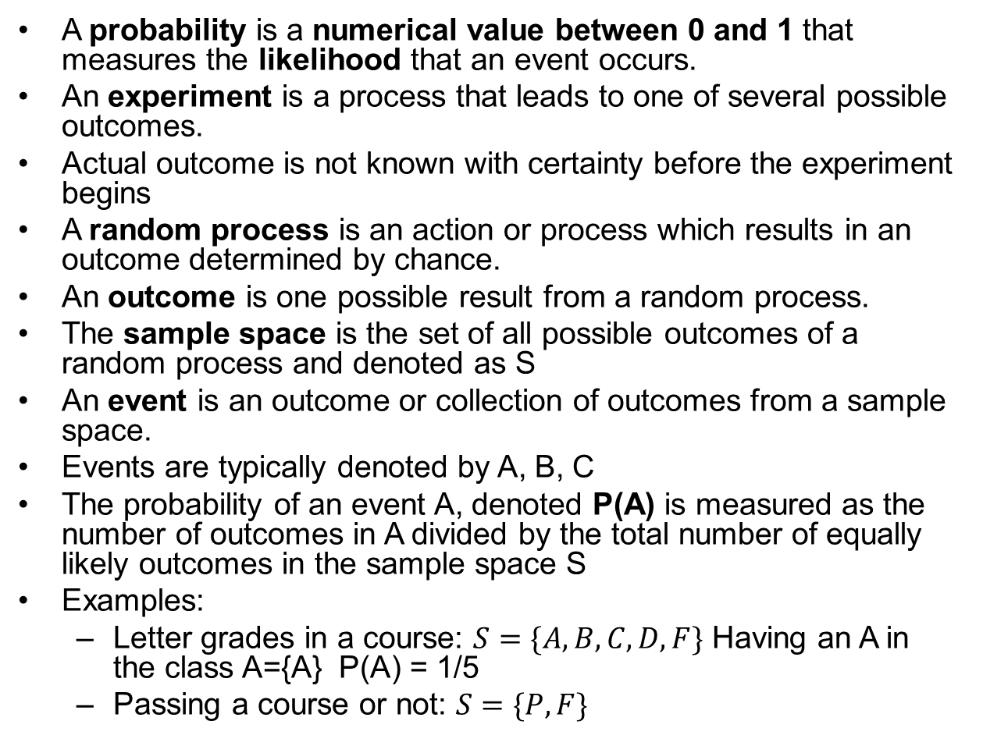
Probability
A probability is a numerical value between 0 and 1 that measures the likelihood that an event occurs.
An experiment is a process that leads to one of several possible outcomes.
Actual outcome is not known with certainty before the experiment begins
A random process is an action or process which results in an outcome determined by chance.
An outcome is one possible result from a random process.
The sample space is the set of all possible outcomes of a random process and denoted as S
An event is an outcome or collection of outcomes from a sample space.
Events are typically denoted by A, B, C
The probability of an event A, denoted P(A) is measured as the number of outcomes in A divided by the total number of equally likely outcomes in the sample space S
Examples:
Letter grades in a course: $S=\{A,B,C,D,F\}$ Having an A in the class A={A} P(A) = 1/5
Passing a course or not: $S=\{P, F\}$

Slide 44

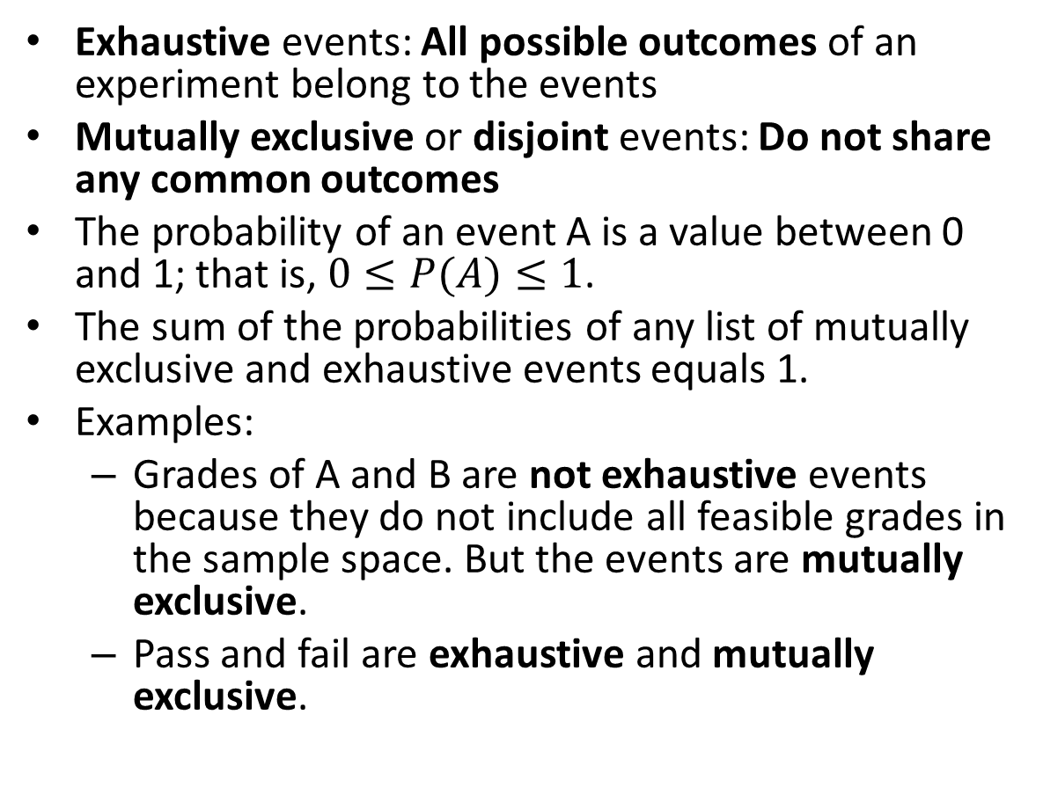
Probability
Exhaustive events: All possible outcomes of an experiment belong to the events
Mutually exclusive or disjoint events: Do not share any common outcomes
The probability of an event A is a value between 0 and 1; that is, $0≤P(A)≤1$.
The sum of the probabilities of any list of mutually exclusive and exhaustive events equals 1.
Examples:
Grades of A and B are not exhaustive events because they do not include all feasible grades in the sample space. But the events are mutually exclusive.
Pass and fail are exhaustive and mutually exclusive.

Slide 45
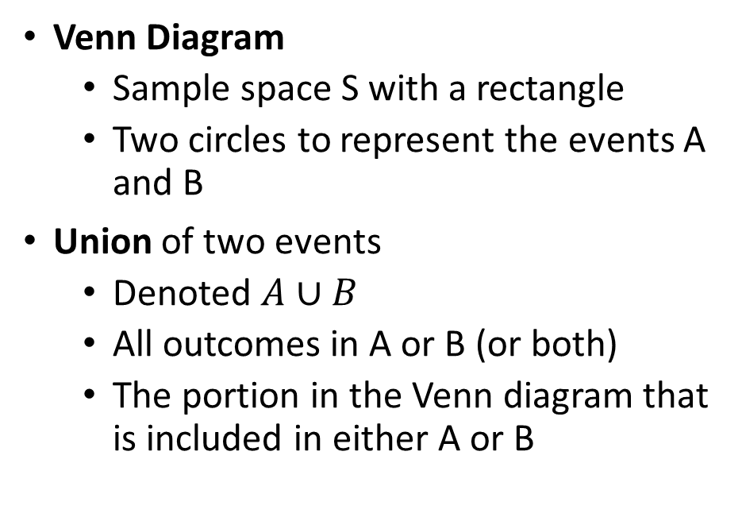
Probability
Venn Diagram
Sample space S with a rectangle
Two circles to represent the events A and B
Union of two events
Denoted $A∪B$
All outcomes in A or B (or both)
The portion in the Venn diagram that is included in either A or B

Slide 46
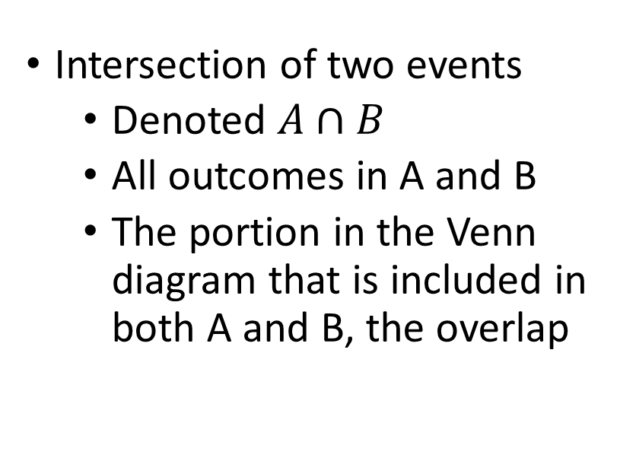
Probability
Intersection of two events
Denoted $A∩B$
All outcomes in A and B
The portion in the Venn diagram that is included in both A and B, the overlap

Slide 47
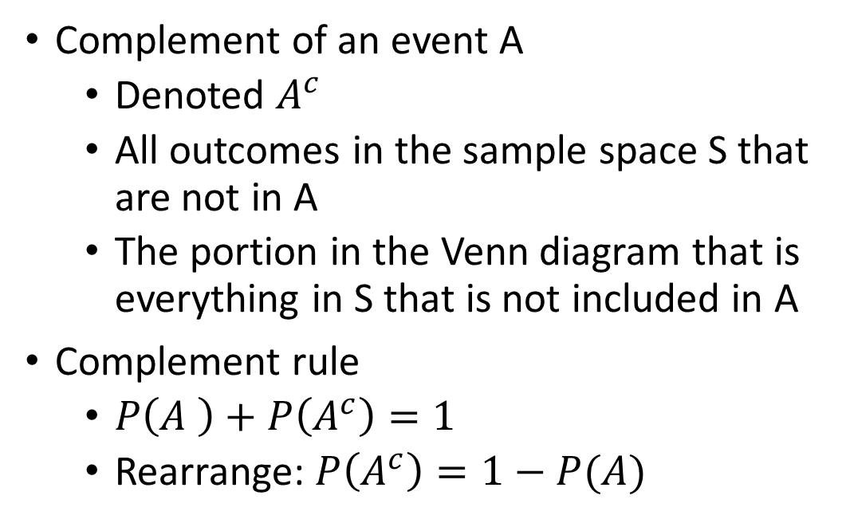
Probability
Complement of an event A
Denoted $A^{c}$
All outcomes in the sample space S that are not in A
The portion in the Venn diagram that is everything in S that is not included in A
Complement rule
$P\left(A \right)+P\left(A^{c}\right)=1$
Rearrange: $P\left(A^{c}\right)=1−P(A)$

Slide 48
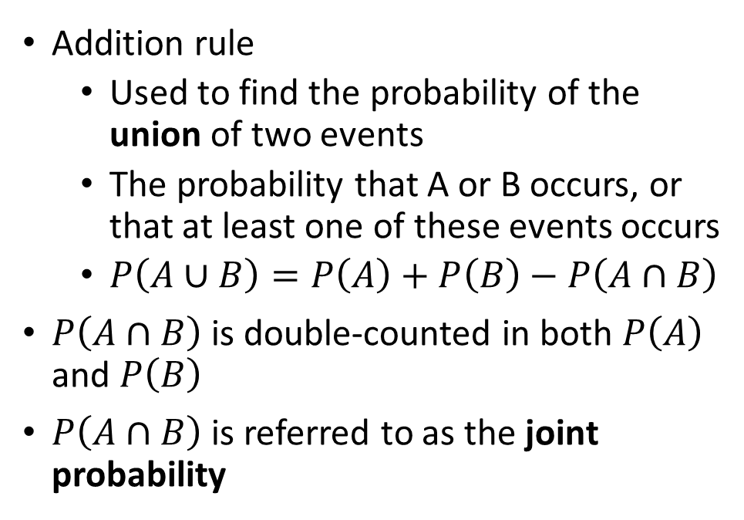
Probability
Addition rule
Used to find the probability of the union of two events
The probability that A or B occurs, or that at least one of these events occurs
$P\left(A∪B\right)=P\left(A\right)+P\left(B\right)−P\left(A∩B\right)$
$P\left(A∩B\right)$ is double-counted in both $P\left(A\right)$ and $P\left(B\right)$
$P\left(A∩B\right)$ is referred to as the joint probability

Slide 49
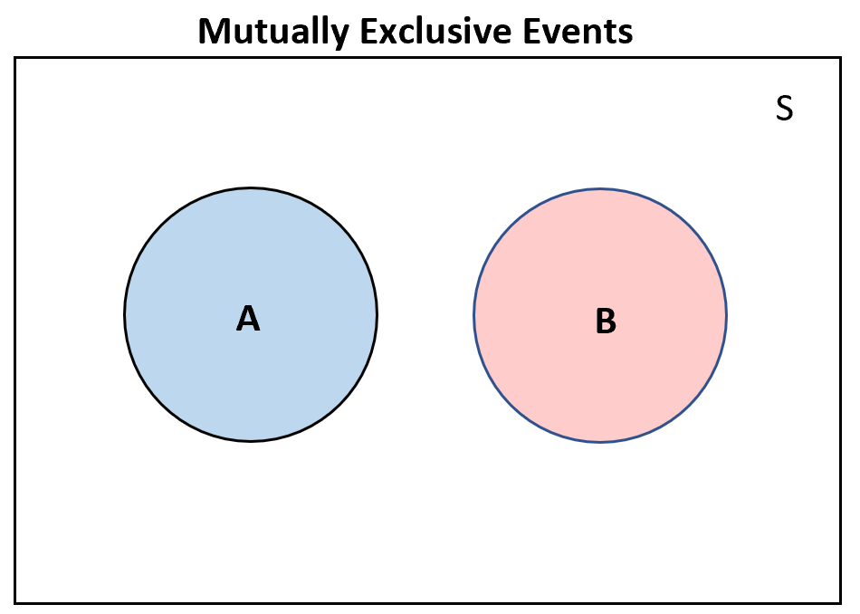
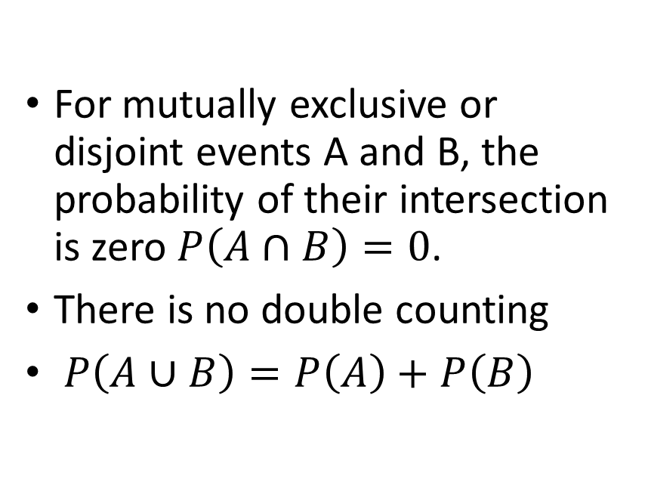
Probability
For mutually exclusive or disjoint events A and B, the probability of their intersection is zero $P\left(A∩B\right)=0$.
There is no double counting
$P\left(A∪B\right)=P\left(A\right)+P\left(B\right)$

Slide 50
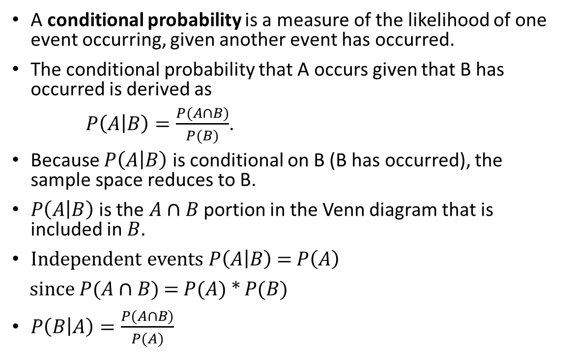
Conditional Probability
A conditional probability is a measure of the likelihood of one event occurring, given another event has occurred.
The conditional probability that A occurs given that B has occurred is derived as
$P\left(A | B\right)=\frac{P(A∩B)}{P(B)}$.
Because $P\left(A | B\right)$ is conditional on B (B has occurred), the sample space reduces to B.
$P\left(A | B\right)$is the $A∩B$portion in the Venn diagram that is included in $B$.
Independent events $P\left(A | B\right)$ = $P\left(A\right)$
since $P(A∩B)$ = $P(A)$ * $P(B)$
$P\left(B | A\right)=\frac{P(A∩B)}{P(A)}$

Slide 51
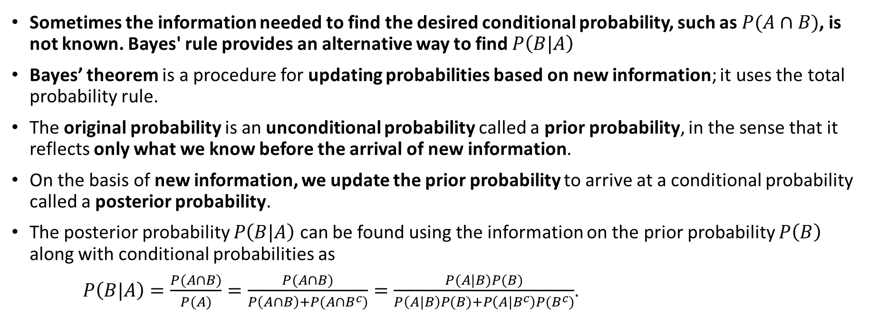
Bayes’ Rule
Sometimes the information needed to find the desired conditional probability, such as $P(A∩B)$, is not known. Bayes' rule provides an alternative way to find $P\left(B|A\right)$
Bayes’ theorem is a procedure for updating probabilities based on new information; it uses the total probability rule.
The original probability is an unconditional probability called a prior probability, in the sense that it reflects only what we know before the arrival of new information.
On the basis of new information, we update the prior probability to arrive at a conditional probability called a posterior probability.
The posterior probability $P\left(B|A\right)$ can be found using the information on the prior probability $P\left(B\right)$ along with conditional probabilities as
$P\left(B|A\right)=\frac{P(A∩B)}{P(A)}=\frac{P(A∩B)}{P\left(A∩B\right)+P(A∩B^{c})}=\frac{P(A|B)P(B)}{P\left(A|B\right)P(B)+P\left(A|B^{c}\right)P(B^{c})}$.

Slide 52
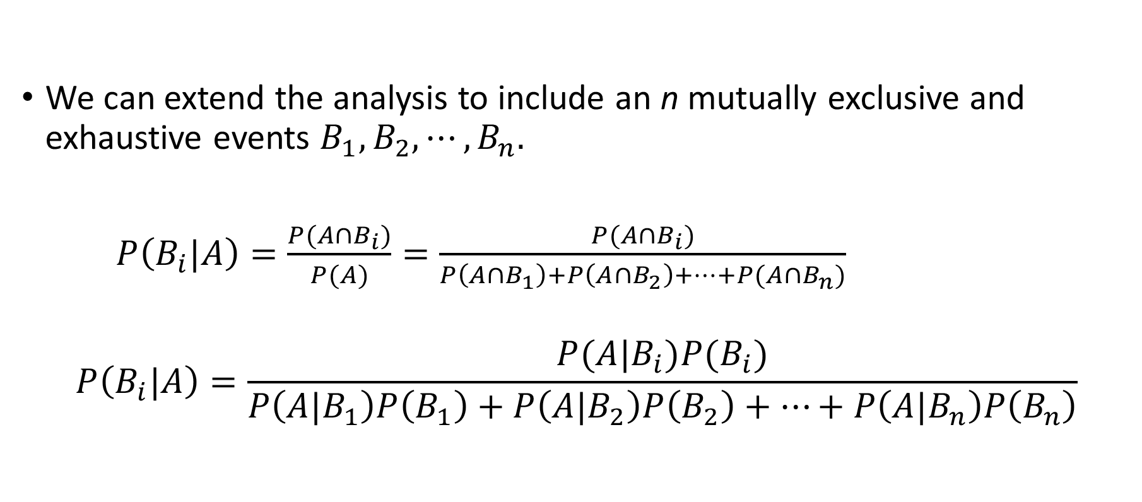
Bayes’ Rule
We can extend the analysis to include an n mutually exclusive and exhaustive events $B_{1},B_{2},⋯,B_{n}.$
$P\left(B_{i}|A\right)=\frac{P(A∩B_{i})}{P(A)}=\frac{P(A∩B_{i})}{P\left(A∩B_{1}\right)+P\left(A∩B_{2}\right)+⋯+P(A∩B_{n})}$
$$P\left(B_{i}|A\right)=\frac{P(A|B_{i})P(B_{i})}{P\left(A|B_{1}\right)P\left(B_{1}\right)+P\left(A|B_{2}\right)P\left(B_{2}\right)+⋯+P\left(A|B_{n}\right)P\left(B_{n}\right)}$$

Slide 53
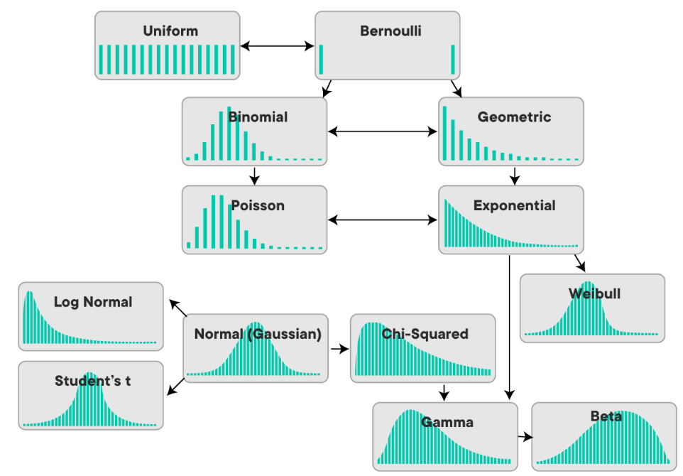
Probability Distributions

Slide 54

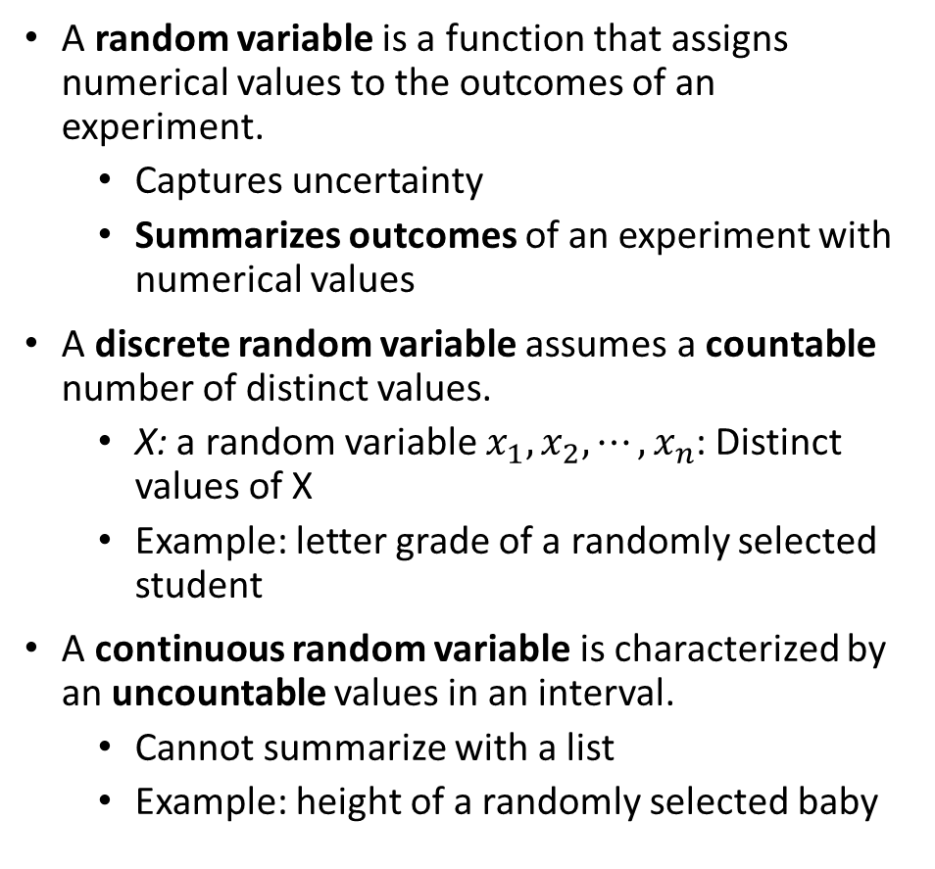
Random variables
A random variable is a function that assigns numerical values to the outcomes of an experiment.
Captures uncertainty
Summarizes outcomes of an experiment with numerical values
A discrete random variable assumes a countable number of distinct values.
X: a random variable $x_{1},x_{2},⋯,x_{n}$: Distinct values of X
Example: letter grade of a randomly selected student
A continuous random variable is characterized by an uncountable values in an interval.
Cannot summarize with a list
Example: height of a randomly selected baby

Slide 55

Probability distributions
A random variable's probability distribution gives the probability of occurrence for the random variable's possible numerical values.
It can be
visualized with graphs and
described with numerical summaries.
The statistical inference methods and modeling often rely on probability distributions

Slide 56
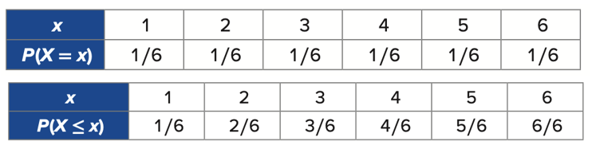
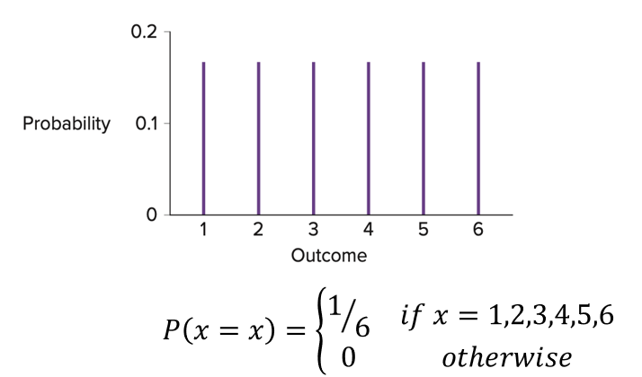
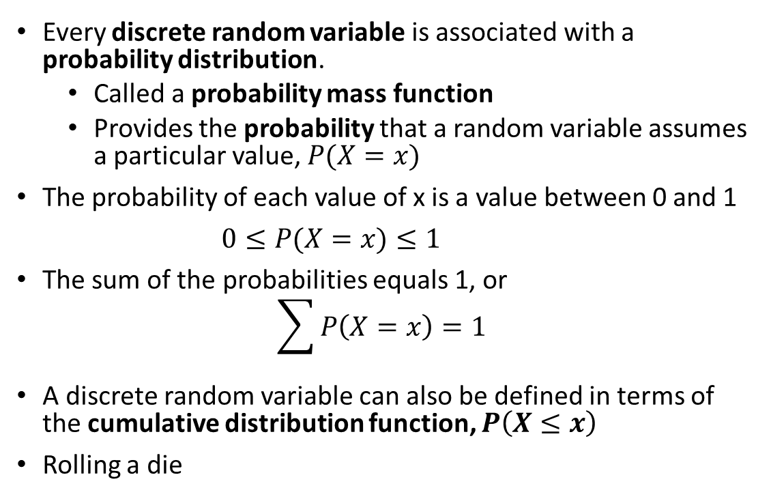
Probability distributions
Every discrete random variable is associated with a probability distribution.
Called a probability mass function
Provides the probability that a random variable assumes a particular value, $P(X=x)$
The probability of each value of x is a value between 0 and 1
$0≤P(X=x)≤1$
The sum of the probabilities equals 1, or
$$\sum{P\left(X=x\right)=1}$$
A discrete random variable can also be defined in terms of the cumulative distribution function, $P\left(X≤x\right)$
Rolling a die

Slide 57

Expected value, mean, variance, standard deviation
Expected value $E(X)$ = Mean $μ$ central location
Weighted average of all possible values of X
$E(X)$ or $μ$, indicates
It is calculated as $E\left(X\right)=μ=\sum{x_{i}P\left(X=x_{i}\right)}$
The variance and standard deviation are both measures of variability.
The variance is denoted $Var\left(X\right)$ or $σ^{2}$
The variance is calculated as
$Var(X)=σ^{2}=\sum{{\left(x_{i}−μ\right)}^{2}P\left(X=x_{i}\right)}$
The standard deviation is denoted by $SD(X)$ or $σ$
Indicates if values are clustered about the mean or widely scattered

Slide 58

Bernoulli Distribution
A discrete random variable in which the only possible values are 0 and 1 follows a Bernoulli distribution.
Bernoulli distributions typically describe non-numerical outcomes in which a value of 1 indicates a "success" and a value of 0 indicates a "failure".
X: Describe a randomly selected patient has a tumor in which 1 indicates the tumor is malignant and 0 indicates it is bening
The parameters of a probability distribution determine the distribution's shape and probabilities. The Bernoulli distribution is specified by one parameter, p, which is the probability of a "success" or 1.
Parameters are X=binomial(n, p)
E(X) = μ = p
σ² = p * (1 - p)

Slide 59

Binomial Distribution
The outcome of a random process is usually observed more than once.
Ex: Randomly select 25 students. The total number of students who passed can be thought of as the sum of n = 25 independent Bernoulli random variables.
A binomial random variable X is defined as the number of successes achieved in the n trials of a Bernoulli process.
The possible values are 0, 1, … , n
The binomial distribution or binomial probability distribution shows the probabilities associated with the possible values
Parameters are X=binomial(n, p)
E(X) = μ = n * p
σ² = n * p * (1 - p)

Slide 60

Normal Distribution
Used for continuous random variables.
Symmetric, bell-shaped distribution
Parameters are X=normal(μ, σ)
Standard normal distribution: μ = 0, σ = 1
A normally distributed random variable can be standardized by subtracting the mean and dividing by the standard deviation. Z= (X- μ) / σ
The standardized variable Z of z-scores follows the standard normal distribution, Z=normal(μ=0, σ=1)

Slide 61


t Distribution
Used for continuous random variables.
Similar to normal distribution but has more variability
Symmetric, bell-shaped curve, centered at 0, with a standard deviation greater than 1.
One parameter t(df) df: degrees of freedom
Standard normal distribution: μ = 0, σ = 1
t distribution: μ = 0, σ > 1

Slide 62

Probability distributions in Python
The probability of an event equal to or less than a given value is defined by the cumulative distribution function, or CDF for short. The inverse of the CDF is called the percentage-point function and will give the discrete outcome that is less than or equal to a probability.
PDF: Probability Density Function, returns the probability of a given continuous outcome.
CDF: Cumulative Distribution Function, returns the probability of a value less than or equal to a given outcome.
PPF: Percent-Point Function, returns a discrete value that is less than or equal to the given probability.

Slide 63



Slide 64



Slide 65

Inferential Statistics

Slide 66

Inferential statistics
Inferential statistics refers to drawing conclusions about a larger set of data (population) based on a smaller set of data (sample).
We rely on sample data to make inferences about various characteristics of the population.
Test claims about population(females are paid 20% less)
Estimate quantities about of the population(mean or proportion)
Examples?
The sample proportion of voters who plan to vote by mail is a statistic and estimates the parameter, or the population proportion, of all voters who plan to vote by mail.
BUT SAMPLES ARE DIFFERENT SO THE CALCULATED VAUES VARY!!!
Use many samples?
The overall behavior of a statistic from repeated sampling is described by a sampling distribution.

Slide 67

Central Limit Theorem
The sampling distributions of many statistics ➔ similarly symmetric and bell-shaped.
Central Limit Theorem: Conditions for which a statistic's sampling distribution will approximately follow a normal distribution.
if random samples of size n are drawn from a large population and
n is large enough,
➔sampling distribution of the sample mean will follow approximately a normal distribution.
Notes:
https://learn.zybooks.com/zybook/UNTADTA5340OrhanSpring2024/chapter/3/section/5

Slide 68

Hypothesis testing
Hypothesis test: Evaluate a claim about population parameter by using sample
Conclude
if the claim is plausible or
support alternative explanation
by using the observed data
Null hypothesis(by chance or no effect explanation): H₀
Alternative hypothesis(explanation of an effect): H_{a}
Calculate a statistic from the sample data
Determine the p-value or likelihood by using significance level α (how small p value must be)
Draw a conclusion: Reject H₀ (p <= α) or fail to reject H₀ (p > α)
Notes:
https://learn.zybooks.com/zybook/UNTADTA5340OrhanSpring2024/chapter/3/section/5

Slide 69


Type I and Type II errors
Possibilities
Null hypothesis is true
Alternative hypothesis is true
Hypothesis test result is correct
Hypothesis test result is incorrect
Type I error: Reject null hypothesis although it is true
Type II error: Fail to reject null hypothesis although alternative hypothesis is true

Slide 70


Estimation and confidence interval
Estimates may not be 100% accurate
Provide an interval
Confidence interval: Interval of possible values of the parameter
Estimated value: Best and initial guess of the parameter from sample
Margin of error: Precision (sampling variability and confidence level or interval reliability are considered)
Estimated value ± margin of error
Notes:
https://learn.zybooks.com/zybook/UNTADTA5340OrhanSpring2024/chapter/3/section/5

Slide 71

Inference: Proportions and means
We can answer one or more questions about parameters by inference methods
Inference for one proportion
Inference for two independent proportions
Inference for one mean
Inference for two independent means
Notes:
https://learn.zybooks.com/zybook/UNTADTA5340OrhanSpring2024/chapter/3/section/6

Slide 72

Inference for one proportion
Population parameter: Proportion of x in population
Calculate from sample
Use standardized test statistic
Null hypothesis or alternative hypothesis
proportion of population = proportion of sample
Notes:
https://learn.zybooks.com/zybook/UNTADTA5340OrhanSpring2024/chapter/3/section/6

Slide 73

Notes:
https://learn.zybooks.com/zybook/UNTADTA5340OrhanSpring2024/chapter/3/section/6

Slide 74

Inference for two independent proportions
Compare two independent population parameters: Proportion of x in population1 and proportion of x in population2
Calculate from sample
Use standardized test statistic
Null hypothesis or alternative hypothesis
proportion1 = proportion2
Notes:
https://learn.zybooks.com/zybook/UNTADTA5340OrhanSpring2024/chapter/3/section/6

Slide 75

Notes:
https://learn.zybooks.com/zybook/UNTADTA5340OrhanSpring2024/chapter/3/section/6

Slide 76

Inference for one mean
Population parameter: mean in population
Calculate from sample
Use standardized t-test statistic
Null hypothesis or alternative hypothesis
mean of population = mean of sample
Notes:
https://learn.zybooks.com/zybook/UNTADTA5340OrhanSpring2024/chapter/3/section/6

Slide 77

Notes:
https://learn.zybooks.com/zybook/UNTADTA5340OrhanSpring2024/chapter/3/section/6

Slide 78

Inference for two independent means
Compare two independent population parameters: mean of x in population1 and mean of x in population2
Calculate from sample
Use standardized t-test statistic
Null hypothesis or alternative hypothesis
mean of population - mean of sample is small
Notes:
https://learn.zybooks.com/zybook/UNTADTA5340OrhanSpring2024/chapter/3/section/6

Slide 79

Notes:
https://learn.zybooks.com/zybook/UNTADTA5340OrhanSpring2024/chapter/3/section/6

Slide 80

Inference for proportion in Python
Notes:
https://learn.zybooks.com/zybook/UNTADTA5340OrhanSpring2024/chapter/3/section/6

Slide 81
Note
pd.value_counts(): method to count the number of occurrences of each unique value in a pandas Series or DataFrame column.
Returns a pandas Series object, where each unique value is an index label, and its count is the corresponding value first being the most frequent
import pandas as pd
data = pd.Series(["A", "B", "A", "C", "B", "A"])
counts = data.value_counts()
print(counts)
Output:
A 3
B 2
C 1
dtype: int64

Slide 82




Slide 83

Inference for means in Python
Notes:
https://learn.zybooks.com/zybook/UNTADTA5340OrhanSpring2024/chapter/3/section/6

Slide 84



Slide 85

Questions, Comments, Contributions

